Slide 1

Veeam Recovery Orchestrator
Clean Room
28/05/2025
Claudio Fortuna
Senior Solutions Architect Business Continuity

Slide 2
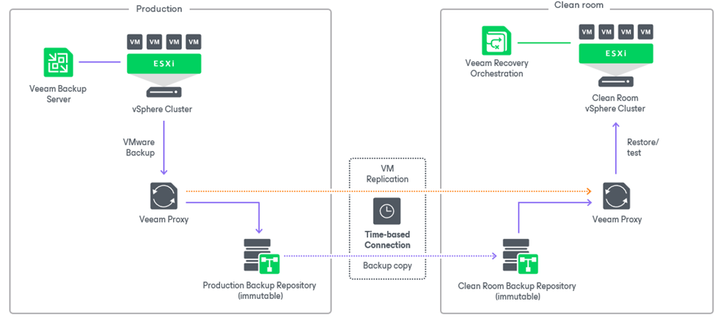
Veeam Recovery Orchestrator Architecture
Reference Design for Clean Rooms and Isolated Environments

Slide 3
VRO Clean Room benefits
Cyberattack recovery: trusted source for clean recovery while having infected and compromised production environments. Reduces the risk of reinfection.
Secure forensic investigation: Once indicators of compromise (IoC) or malicious software are identified, isolated fix testing and resolution can take place before a clean recovery.
Security patch testing: Test security vulnerability exploits and patches without disrupting your production systems.
Recovery testing: Ensure your systems and applications can be successfully recovered by testing backup recovery in a secure, isolated environment without impacting your production systems.
Quarantine: Place your recovered data in a clean room until all testing and verification is complete and there are no signs of infection with malware or other malicious software.
IT sandbox: An isolated environment is ideal for IT operations to test new patches and updates before they are rolled out across production environments.
Documented recovery plans: validate service level agreements (SLAs) to ensure cyber recovery strategy is kept up to date and can be easily verified.

Slide 4
Veeam Recovery Orchestrator Architecture
How the Clean Room backup testing and recovery works

Slide 5
Veeam Recovery Orchestrator Architecture
How the Clean Room backup testing and recovery works

Slide 6
Requirements & Recommendations
Current release requires at least connection to the production vCenter to gather inventory.
Veeam Threat Hunter needs to be enabled on the embedded VBR in the VRO server, and must be connected to the internet at least once during a malware scan to download signatures.
Linux Hardened repository with immutability is recommended for best security.
Other Repository Types are supported.
For S3 compatible Object Storage repository is recommended to assign read-only access from the VBR in the Clean Room.
Repositories based on deduplication appliances (like HPE StoreOnce or Dell Data Domain) are supported but rehydration of data may cause slowdown of backup testing.

Slide 7
Requirements & Recommendations
The Linux repository server must be added in advance to the inventory of the embedded VRO Veeam Backup Server configuration.
The script to attach the repository includes a timeout period of about 10 minutes to ensure the Orchestrator has time to collect the backups and restore points information.
Refrain to keep the repository connected to both the source and target, unless the VBR in the Clean Room has read-only access.
The repository attach script for the Linux repository server should be run only when the production VBR is not connected to the repository.
There are several ways to control the isolation of the environment, like scheduling the up/down of dedicated network interfaces in the Veeam servers, or control the network switch’s ports.
It’s recommended that the network team be involved to allow specific connection ports to be opened during the scheduled open connection window.

Slide 8
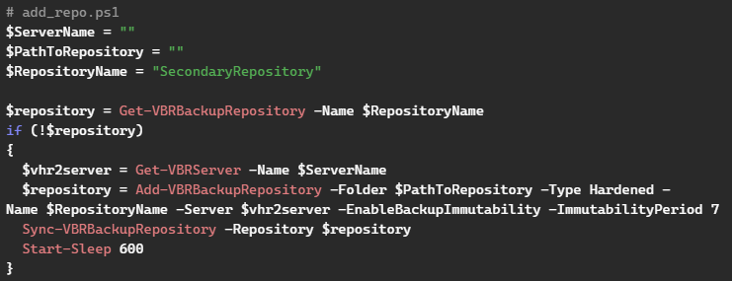
Linux Hardened Repository implementation
The repository in the clean room must be first rescanned and then disconnected after use.
There are 2 ways to handle this:
Schedule the Powershell scripts at the start and end of the close connection window
Run the scripts as pre-plan and post-plan steps in the Orchestrator
Just fill the ServerName and PathToRepository variables to complete the script.
Additional info on this implementation:
How To: Use Veeam Recovery Orchestrator for Clean Rooms! | Veeam Community Resource Hub

Slide 9
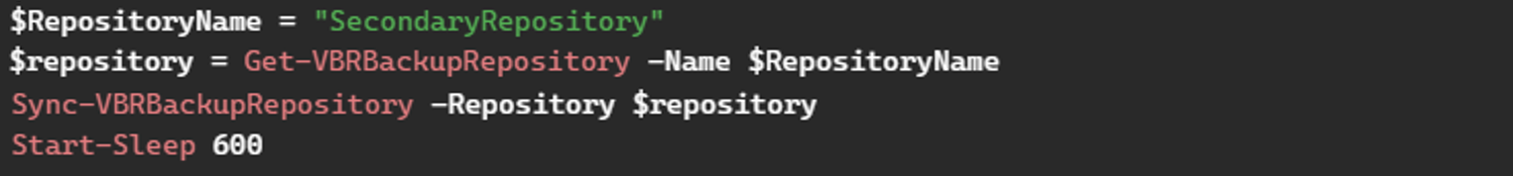
Object Storage Repository implementation
The Object Storage repository in the clean room must be rescanned before use.
There are 2 ways to handle this:
Schedule the Powershell script at the start of the close connection window
Run the script as pre-plan step in the Orchestrator

Slide 10
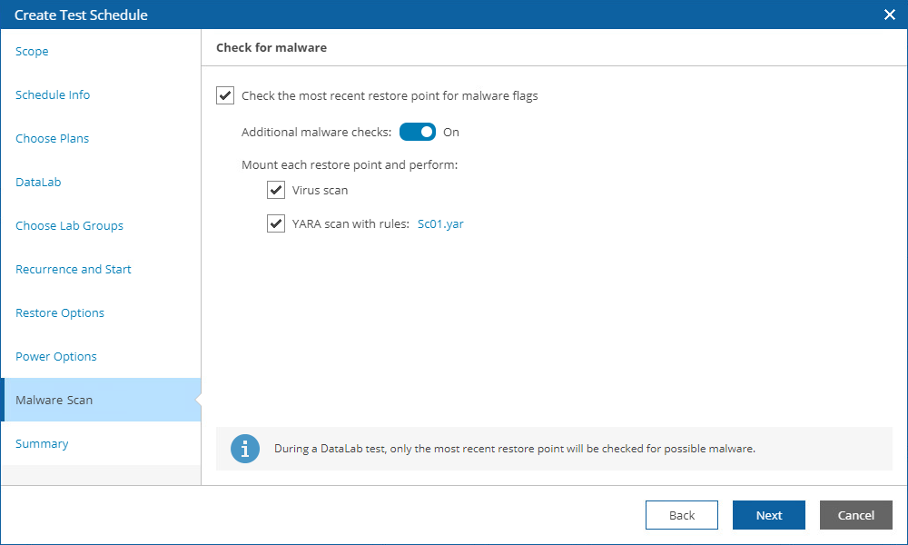
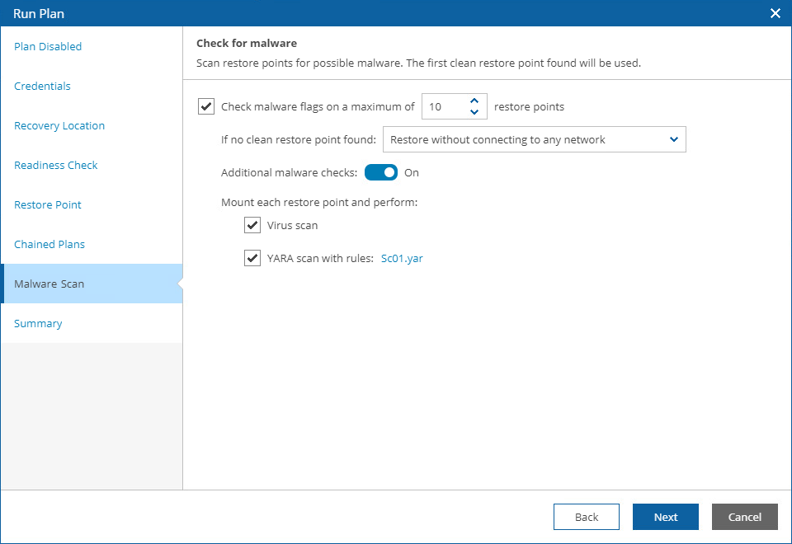
Testing and recovering backups in Clean Room
Malware scan is available for both testing and runs of the orchestrator plans

Slide 11
Notes:
Alexey to finish

